Slide 1

Computer Networks
Application Layer Protocols
S.V.Jansi Rani
Associate Professor / CSE

Slide 2
AGENDA
FTP
Electronic Mail
Telnet
Secure Shell

Slide 3



Slide 4
FTP
File Transfer Protocol (FTP) is the standard protocol provided by TCP/IP for copying a file from one host to another.

Slide 5
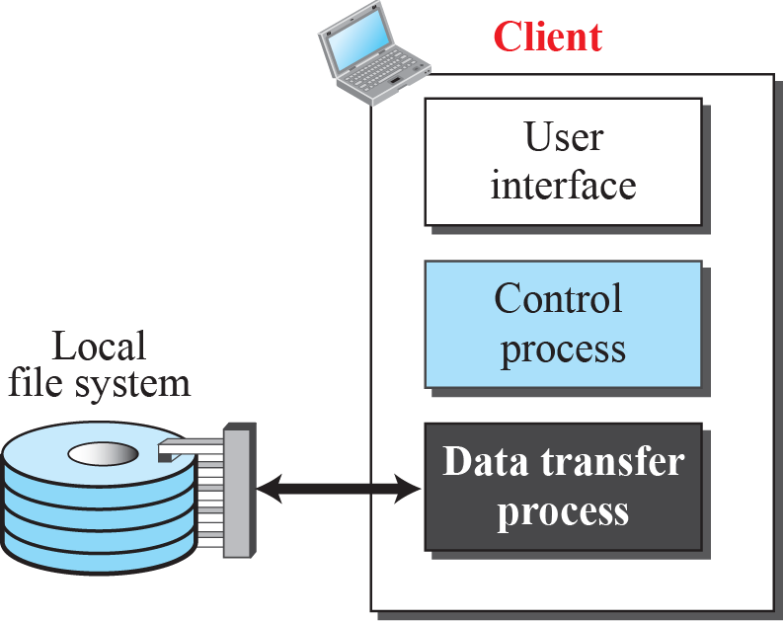
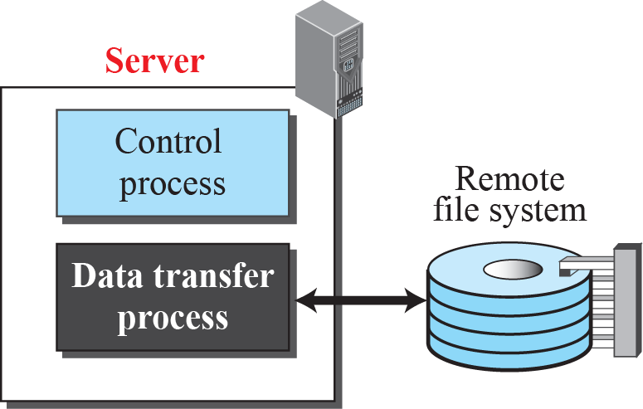
FTP
Port -20 -data, 21- control

Slide 6
Two Connections
The two connections in FTP have different lifetimes. The control connection remains connected during the entire interactive FTP session.
The data connection is opened and then closed for each file transfer activity.
It opens each time commands that involve transferring files are used, and it closes when the file is transferred.

Slide 7
Control Connection
For control communication, FTP uses the same approach as TELNET (discussed later). It uses the NVT ASCII character set as used by TELNET. Communication is achieved through commands and responses. This simple method is adequate for the control connection because we send one command (or response) at a time. Each line is terminated with a two-character (carriage return and line feed) end-of-line token.

Slide 8
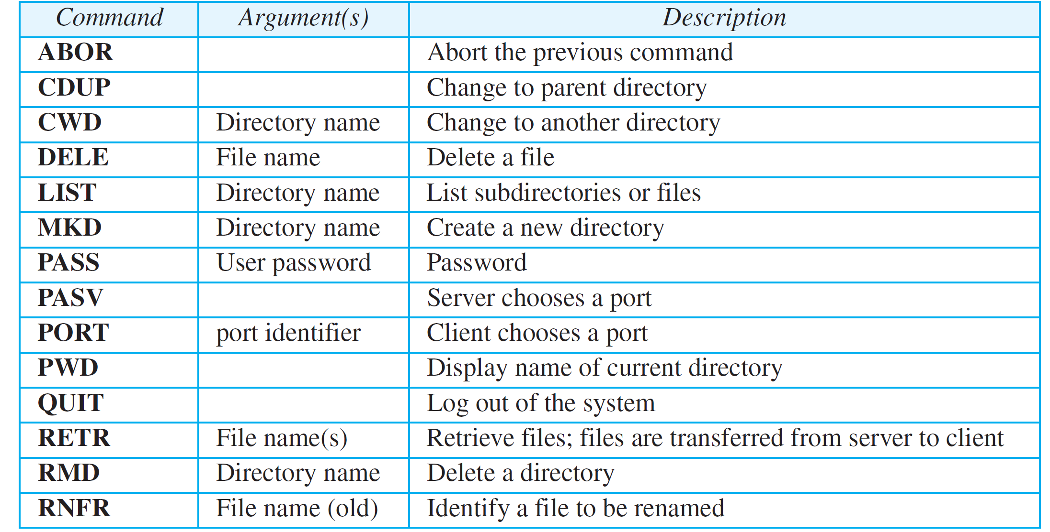
Some FTP commands

Slide 9
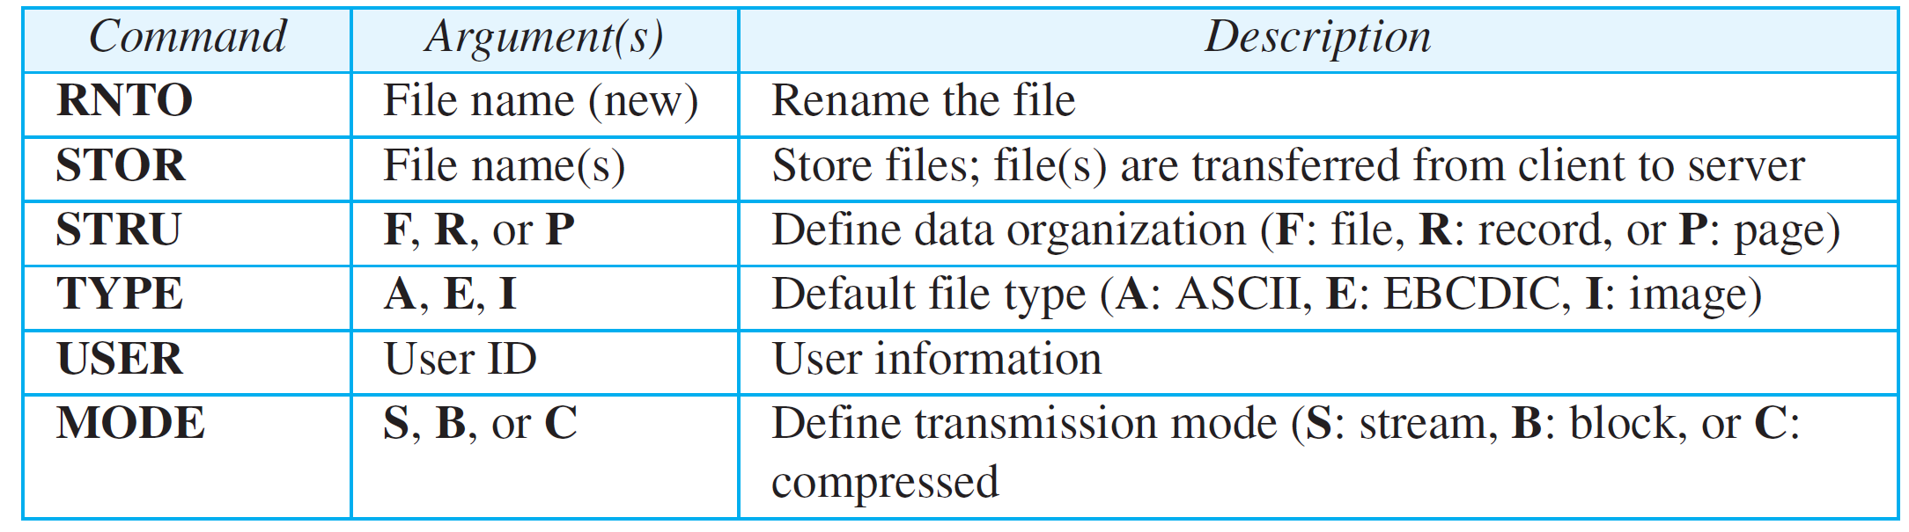
Some FTP commands (continued)

Slide 10
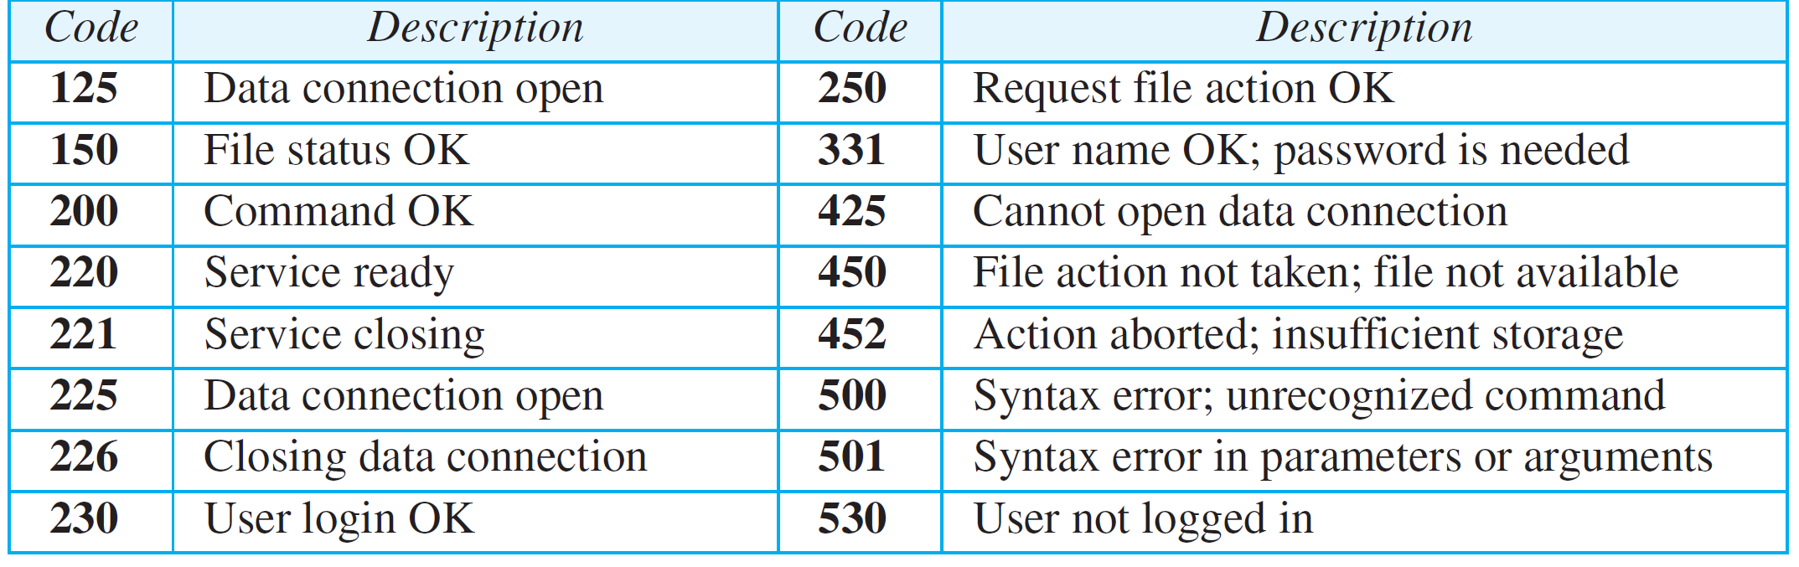
Some responses in FTP

Slide 11
Data Connection
The data connection uses the well-known port 20 at the server site. However, the creation of a data connection is different from the control connection. The following shows the steps:
The client, not the server, issues a passive open using an ephemeral port.
Using the PORT command the client sends this port number to the server.
3. The server receives the port number and issues an active open using the well-known port 20 and the received ephemeral port number.

Slide 12
Example 26.10
Figure 26.11 shows an example of using FTP for retrieving a file. The figure shows only one file to be transferred. The control connection remains open all the time, but the data connection is opened and closed repeatedly. We assume the file is transferred in six sections. After all records have been transferred, the server control process announces that the file transfer is done. Since the client control process has no file to retrieve, it issues the QUIT command, which causes the service connection to be closed.

Slide 13
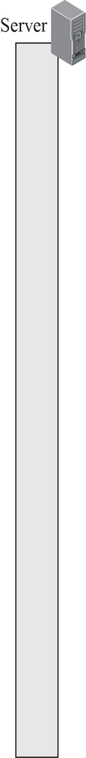

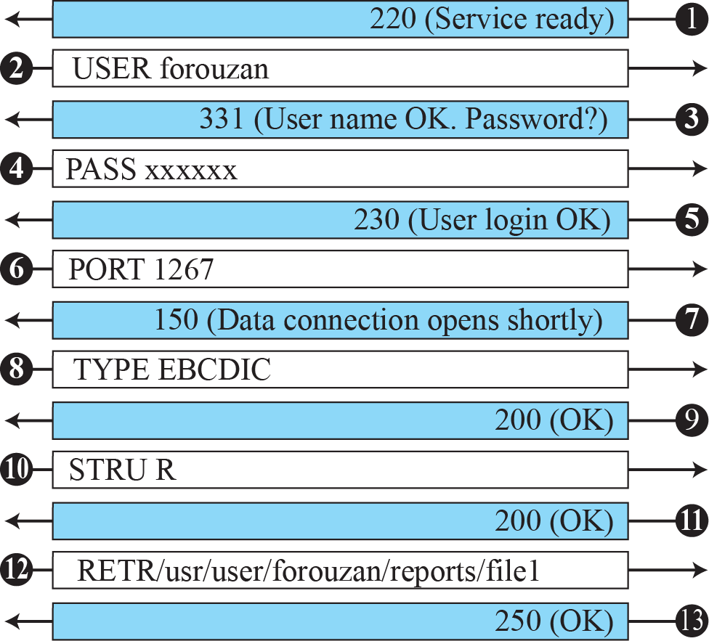
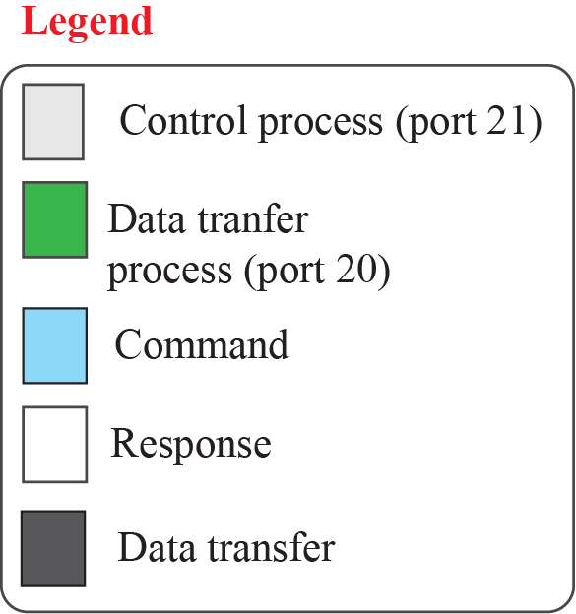

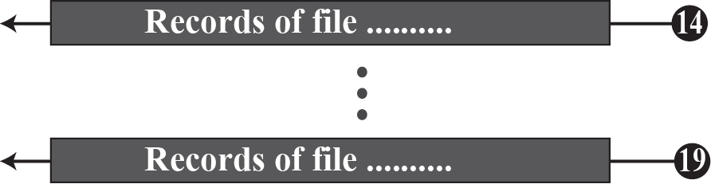
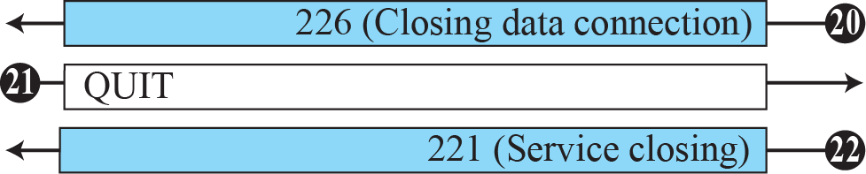
Example 26.12

Slide 14
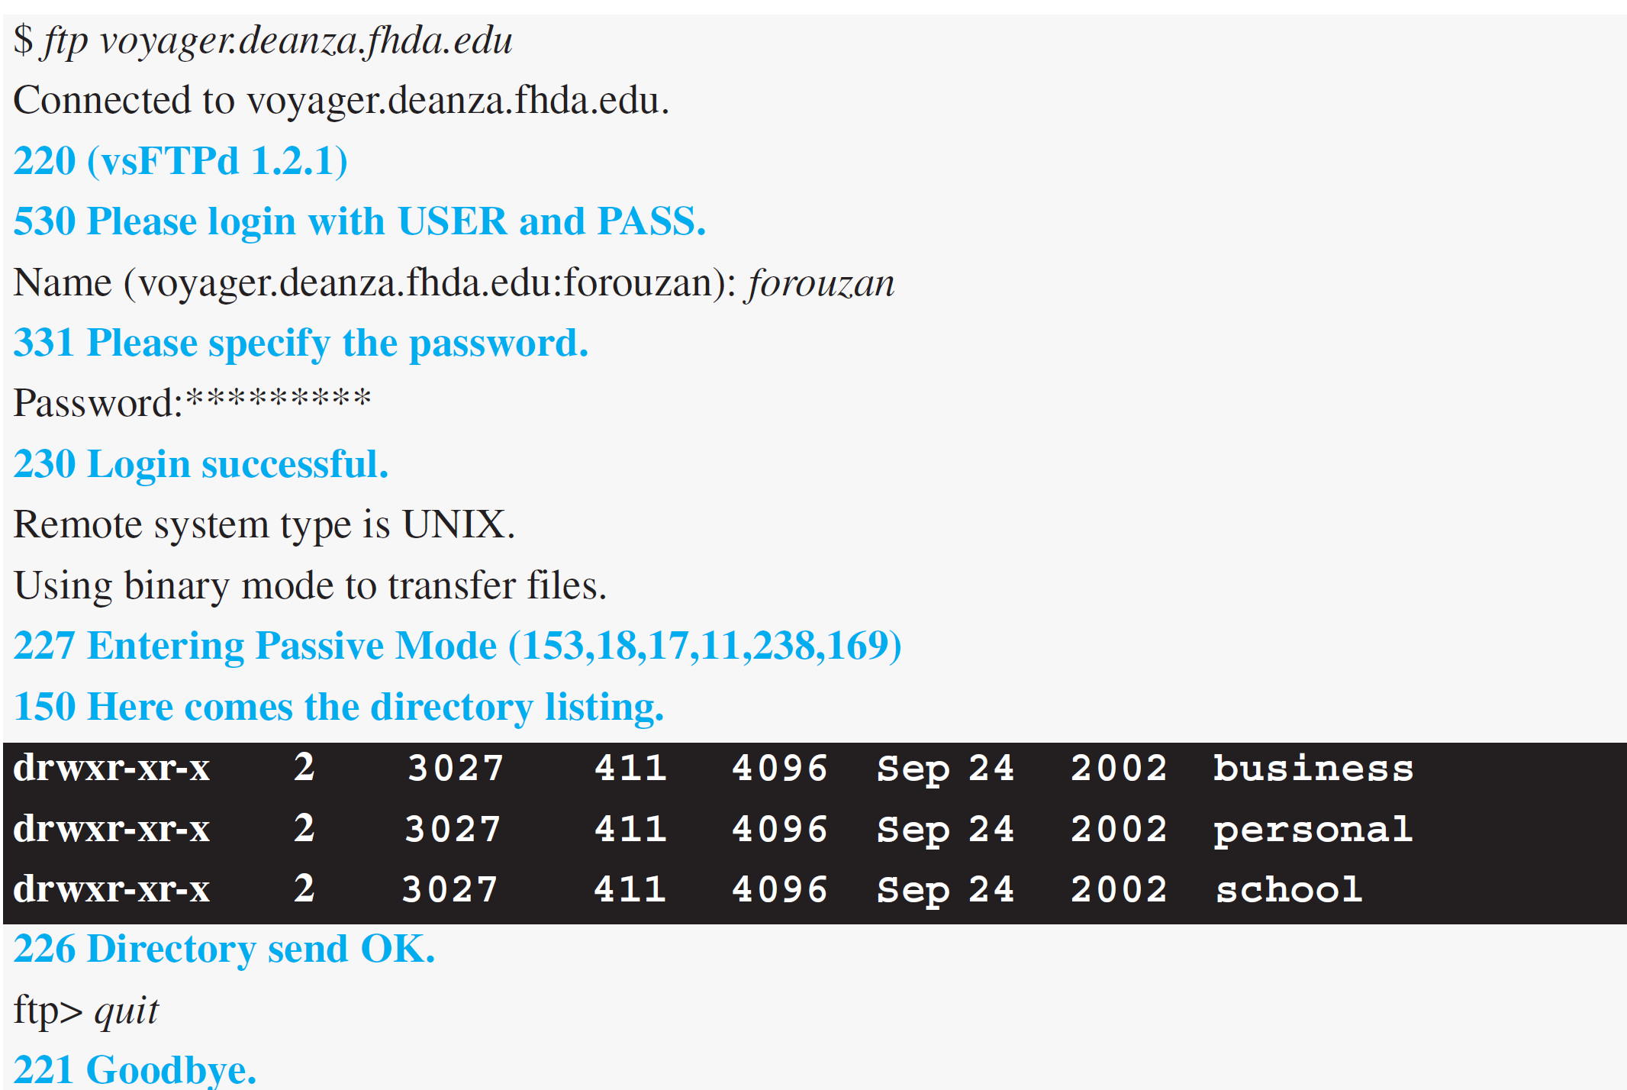
Example 26.11
The following shows an actual FTP session that lists the directories.

Slide 15
Security for FTP
The data transfer connection also transfers data in plaintext, which is insecure.
To be secure, one can add a Secure Socket Layer between the FTP application layer and the TCP layer. In this case FTP is called SSL-FTP.

Slide 16
ELECTRONIC MAIL
Electronic mail (or e-mail) allows users to exchange messages. The nature of this application is different from other applications discussed so far. This means that the idea of client/server programming should be implemented in another way: using some intermediate computers (servers).

Slide 17
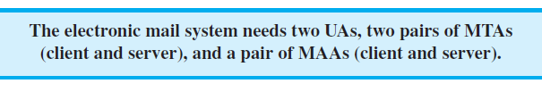
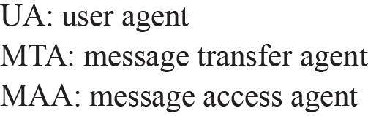
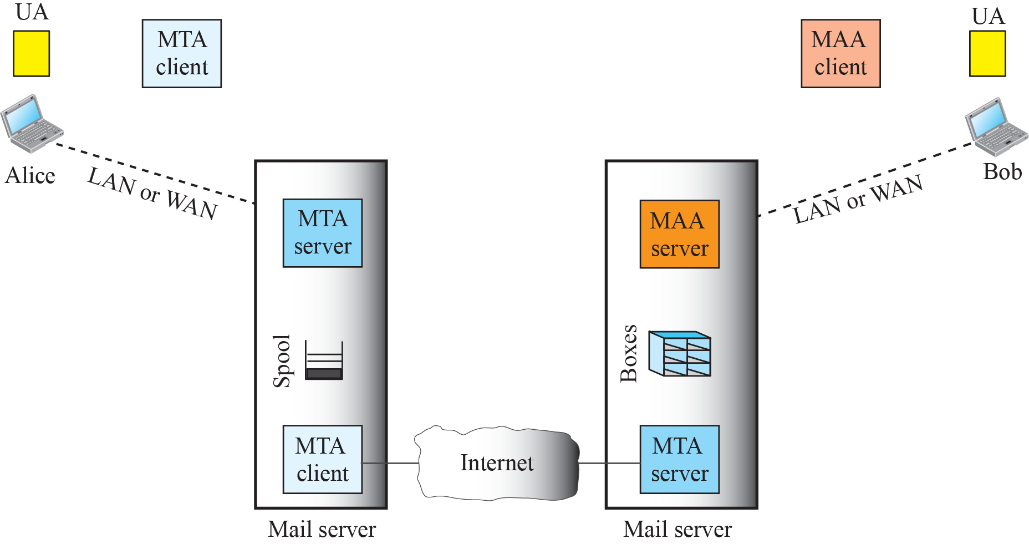
Common scenario

Slide 18
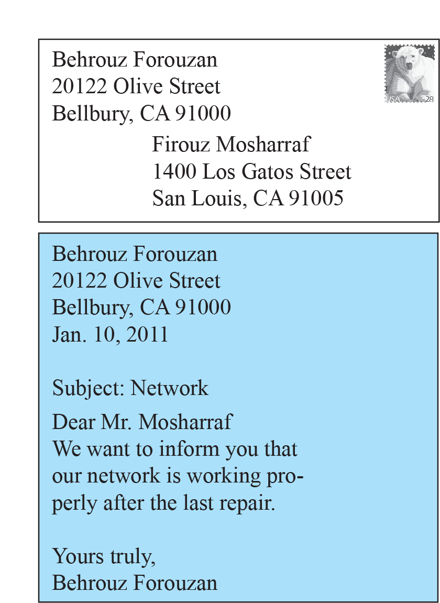
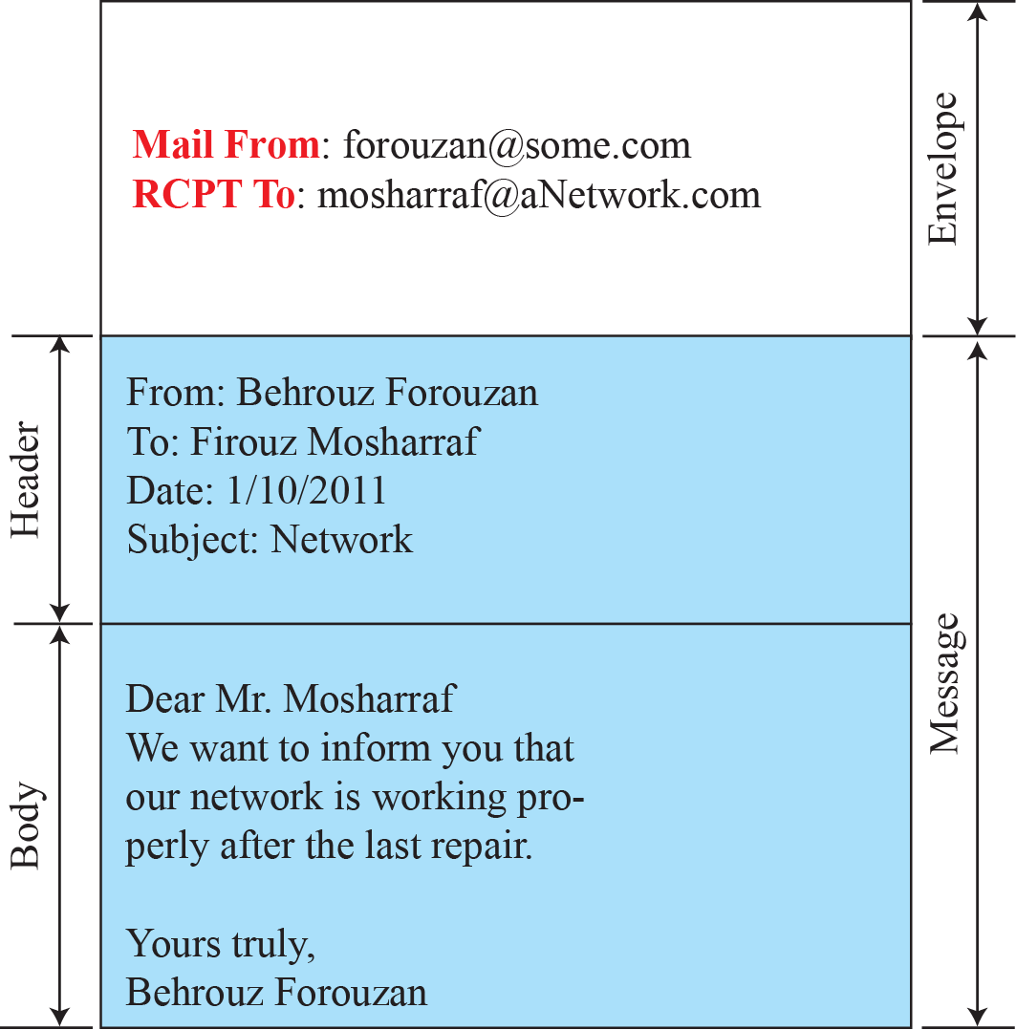


Format of an e-mail

Slide 19
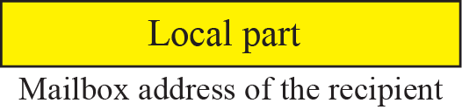

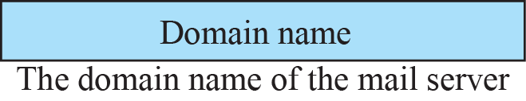
E-mail address

Slide 20
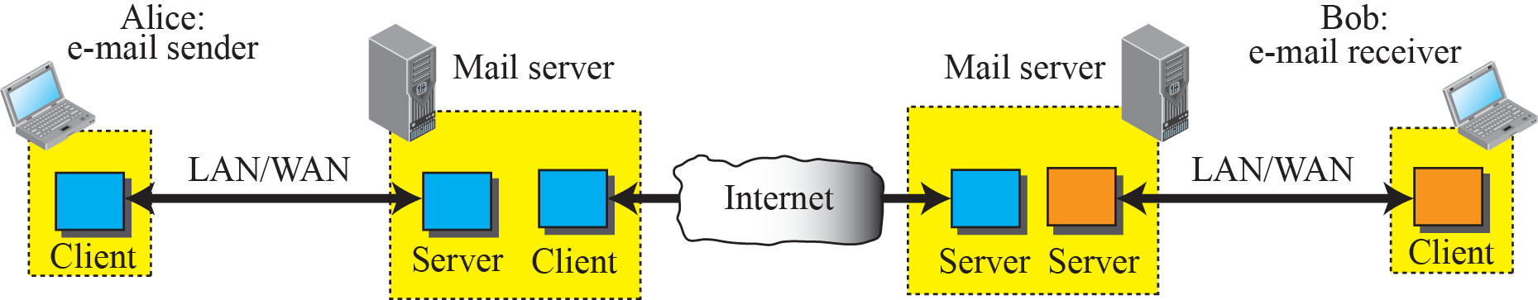
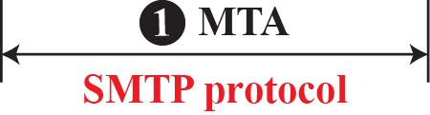
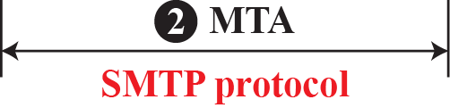

Protocols used in electronic mail

Slide 21
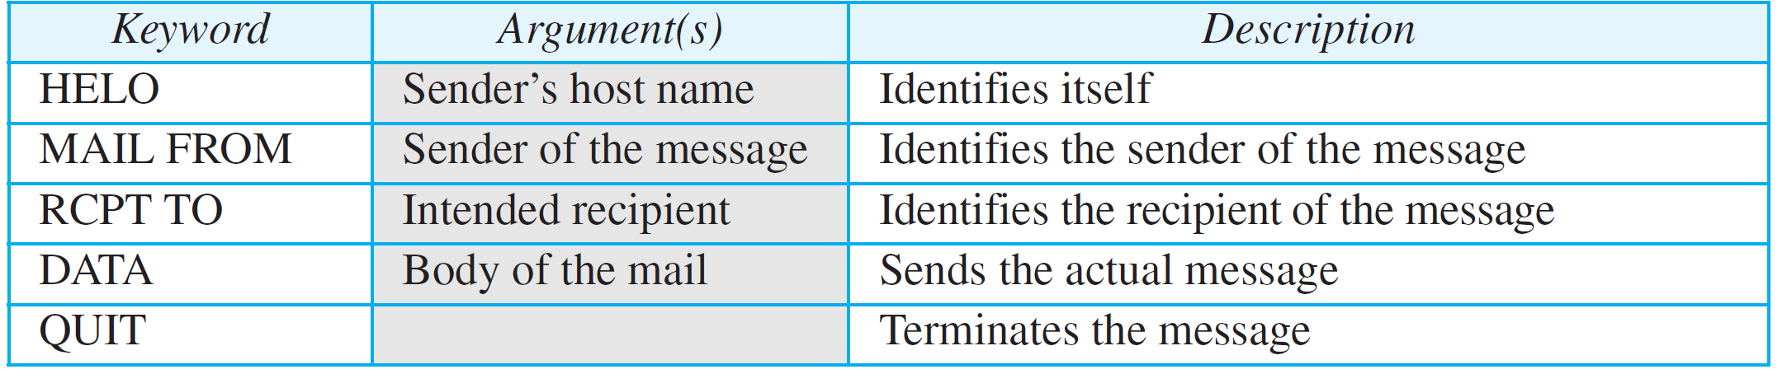
SMTP Commands

Slide 22
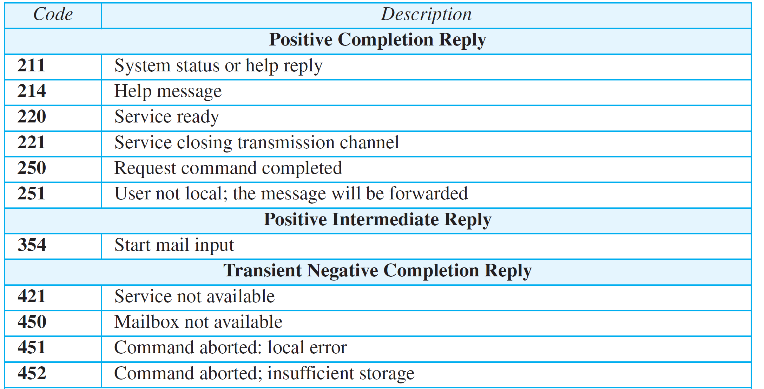
SMTP responses (Continued)

Slide 23
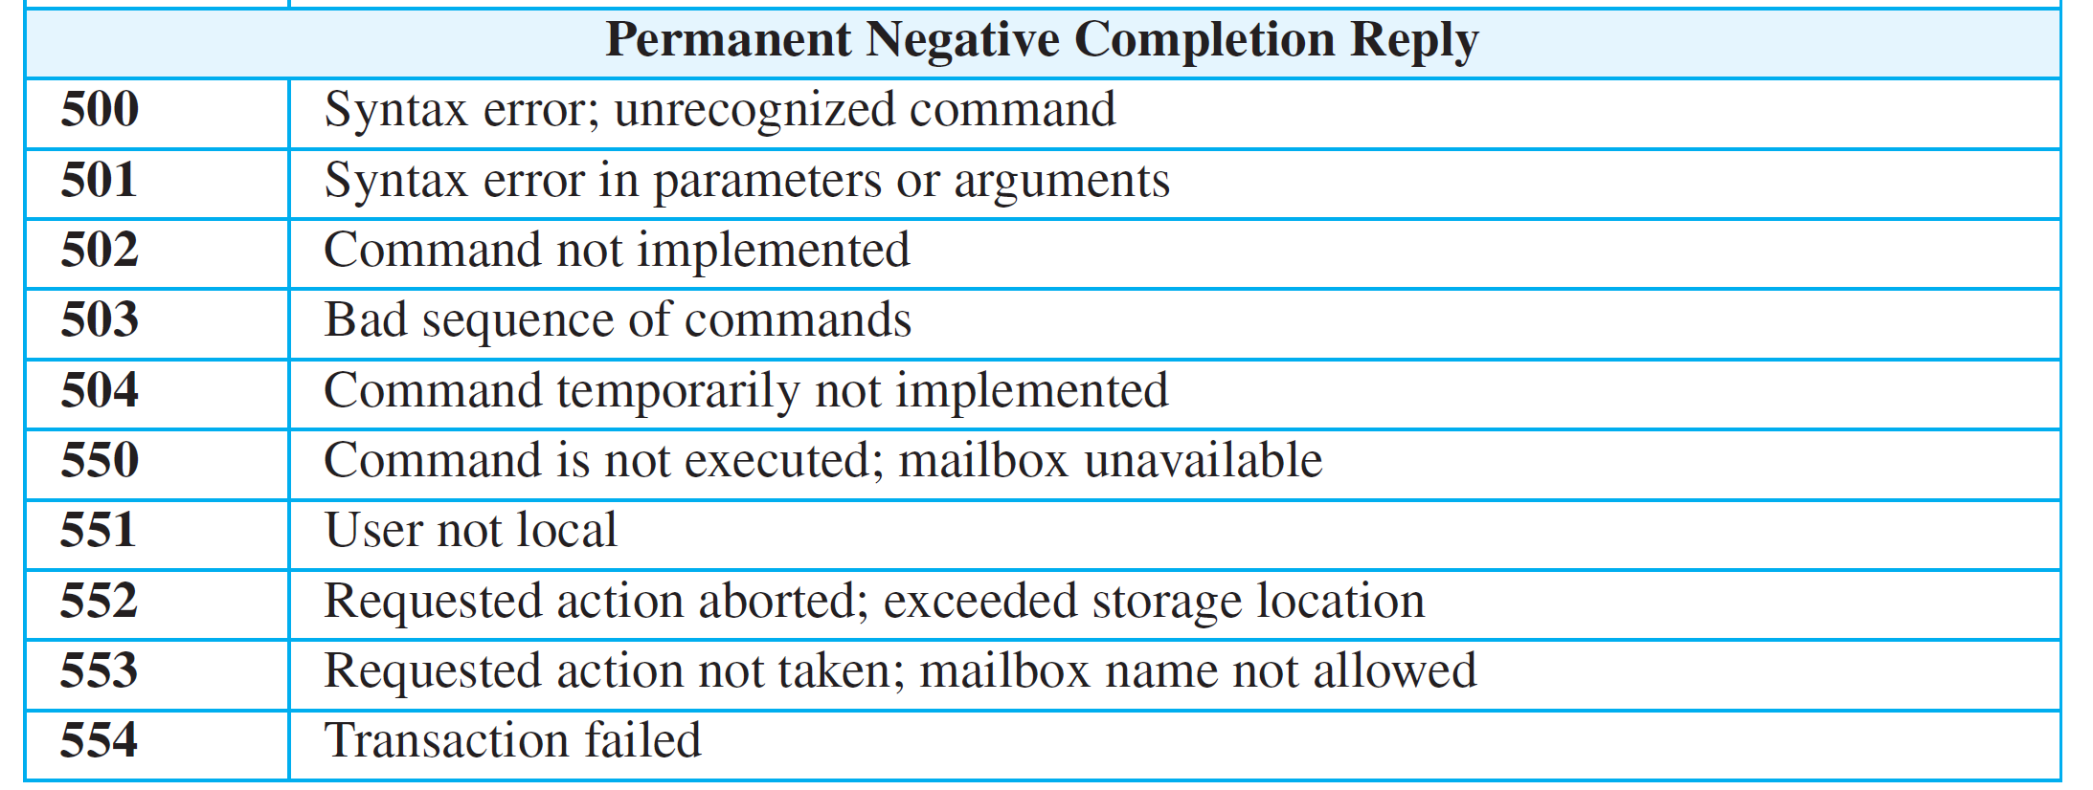
SMTP responses (continued)

Slide 24
Example 26.12
To show the three mail transfer phases, we show all of the steps described above using the information depicted in Figure 26.16. In the figure, we have separated the messages related to the envelope, header, and body in the data transfer section. Note that the steps in this figure are repeated two times in each e-mail transfer: once from the e-mail sender to the local mail server and once from the local mail server to the remote mail server. The local mail server, after receiving the whole e-mail message, may spool it and send it to the remote mail server at another time.

Slide 25
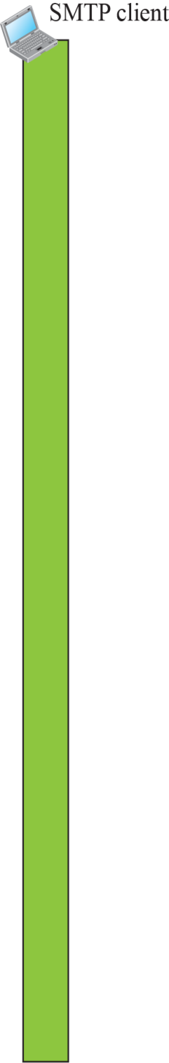
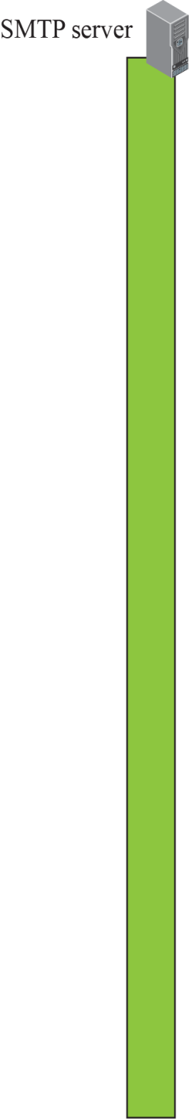
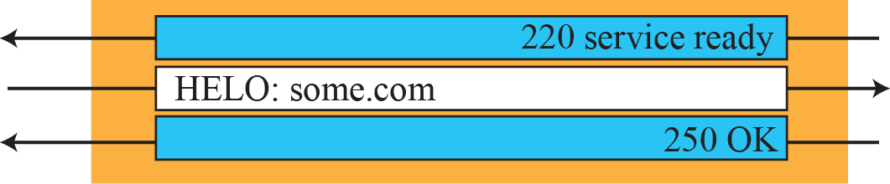
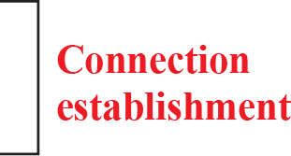
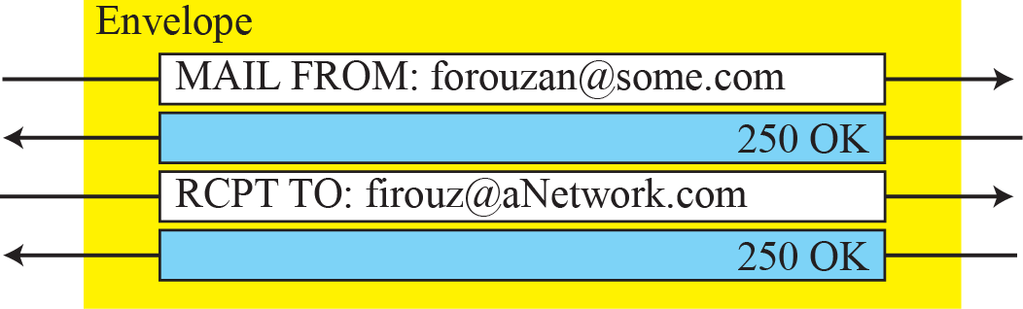

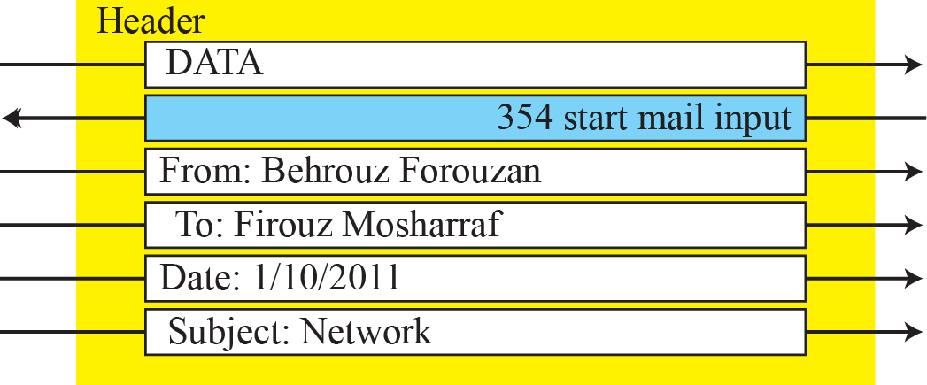
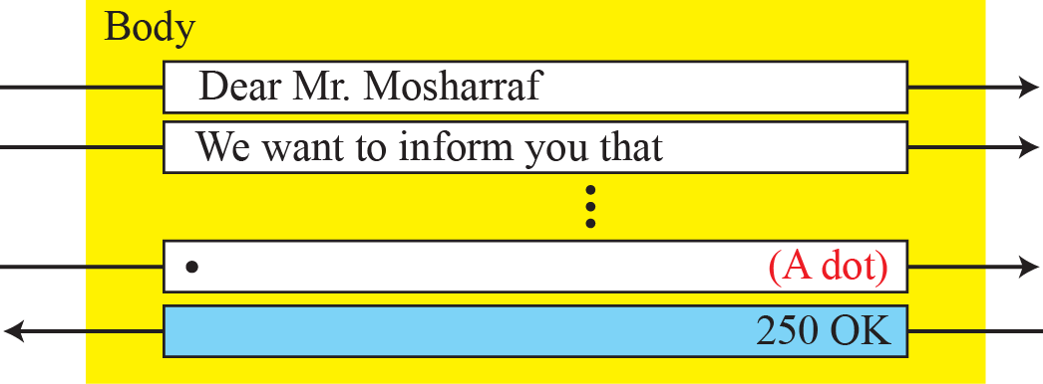
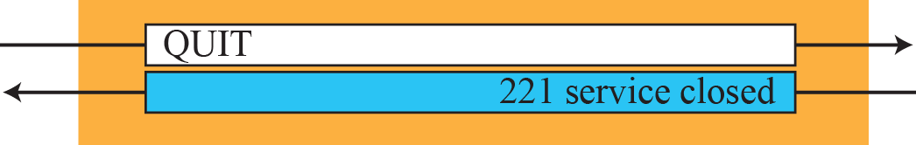

Example 26.12

Slide 26
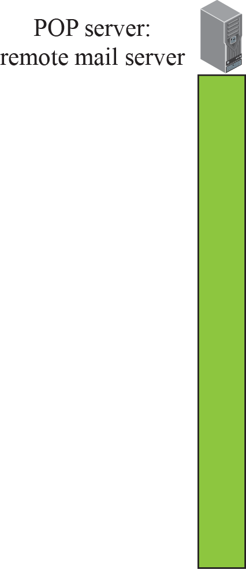
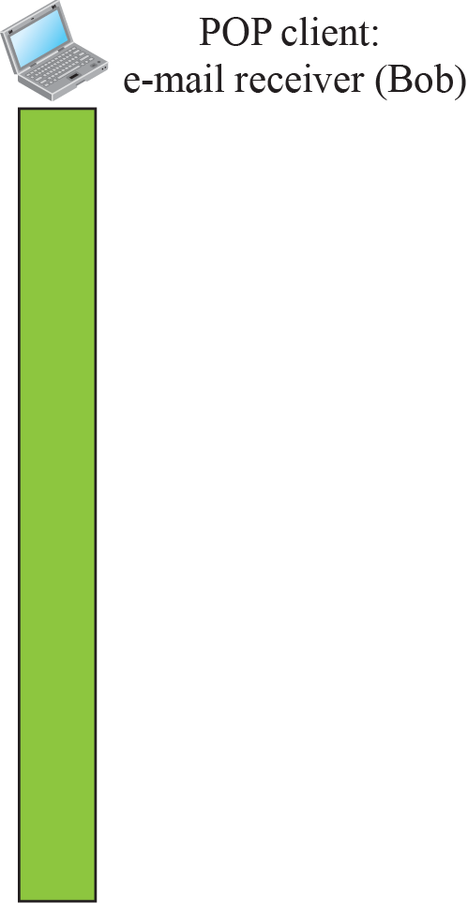
POP3

Slide 27
POP3
POP3 is deficient in several ways.
It does not allow the user to organize her mail on the server;
User cannot have different folders on the server.
POP3 does not allow the user to partially check the contents of the mail before downloading.

Slide 28
IMAP4
IMAP4 provides the following extra functions:
❑ A user can check the e-mail header prior to downloading.
❑ A user can search the contents of the e-mail for a specific string of characters prior to downloading.
❑ A user can partially download e-mail. This is especially useful if bandwidth is limited and the e-mail contains multimedia with high bandwidth requirements.
❑ A user can create, delete, or rename mailboxes on the mail server.
❑ A user can create a hierarchy of mailboxes in a folder for e-mail storage.

Slide 29
MIME
Electronic mail has a simple structure. Its simplicity, however, comes with a price.
It can send messages only in NVT 7-bit ASCII format. In other words, it has some limitations. It cannot be used for languages other than English (such as French,
German, Hebrew, Russian, Chinese, and Japanese).
Also, it cannot be used to send binary files or video or audio data.

Slide 30
MIME
Multipurpose Internet Mail Extensions (MIME) is a supplementary protocol that allows non-ASCII data to be sent through e-mail.
MIME transforms non-ASCII data at the sender site to NVT ASCII data and delivers it to the client MTA to be sent through the Internet.
The message at the receiving site is transformed back to the original data.
We can think of MIME as a set of software functions that transforms non-ASCII data to ASCII data and vice versa.

Slide 31
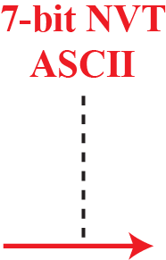
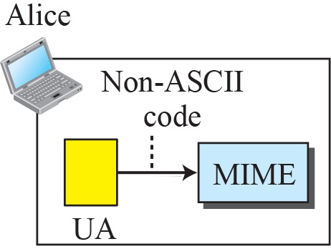
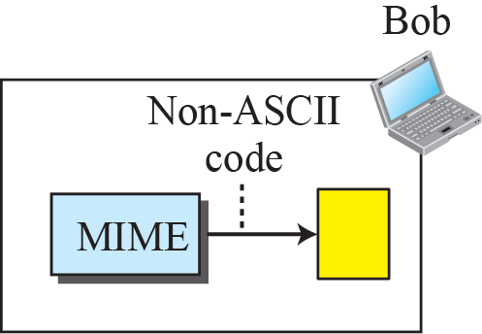
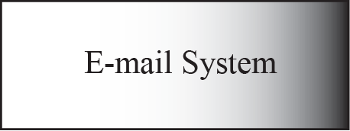
MIME

Slide 32
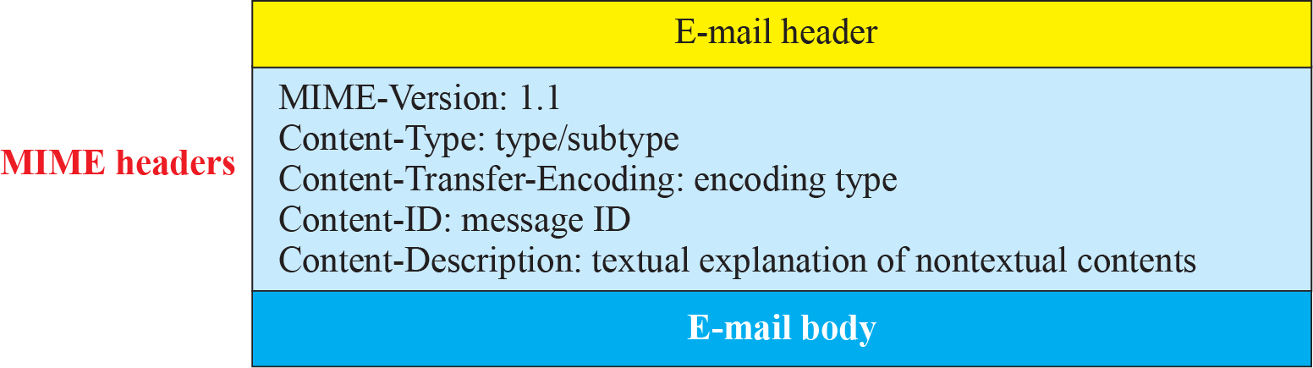
MIME header

Slide 33
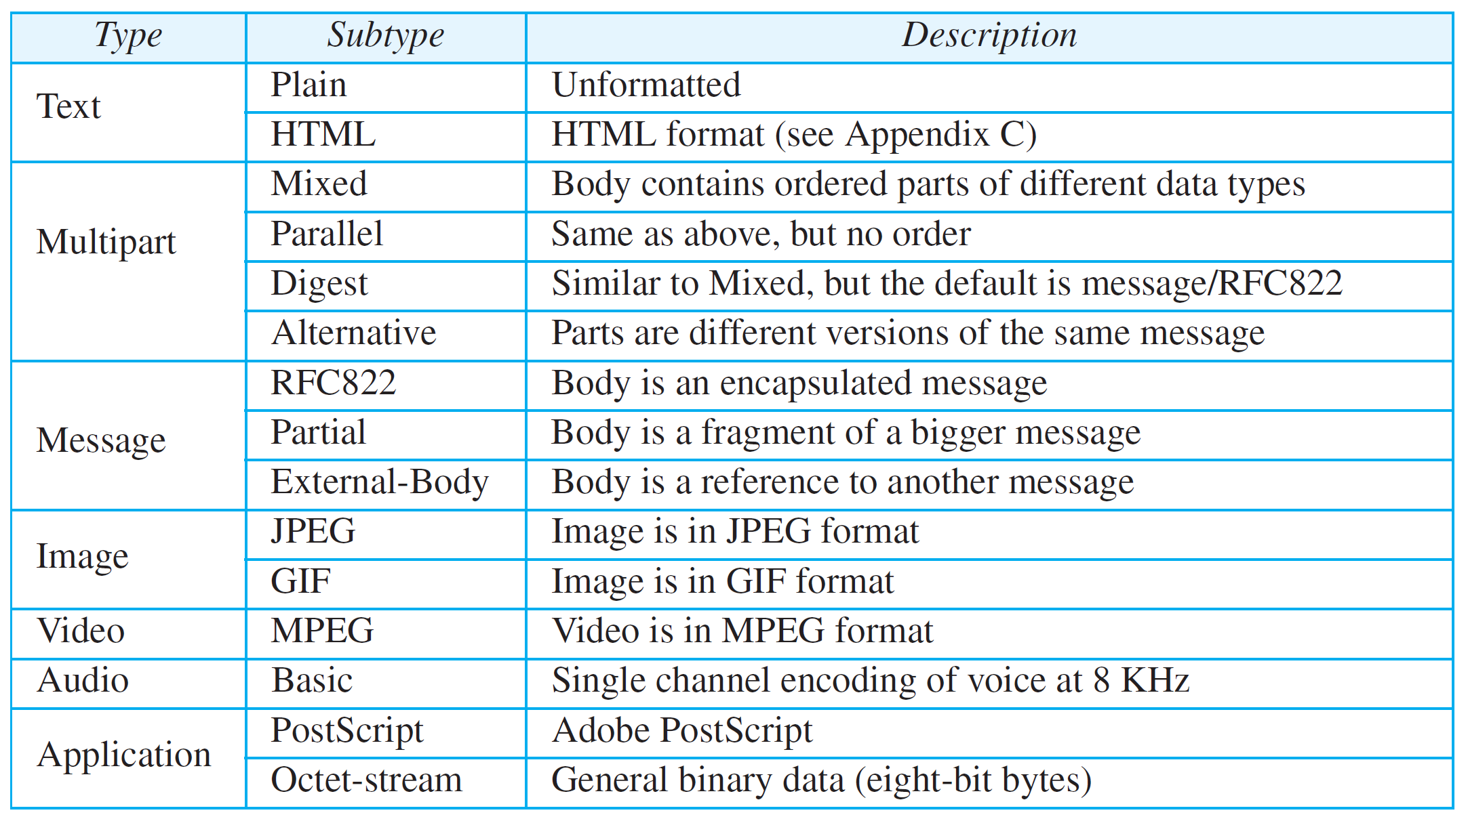
Data Types and Subtypes in MIME

Slide 34
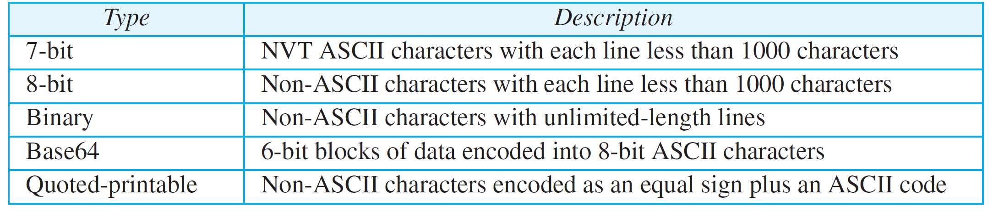
Methods for Content-Transfer-Encoding

Slide 35
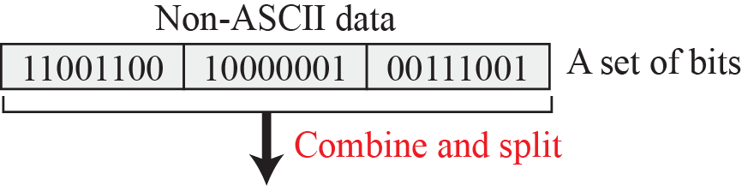
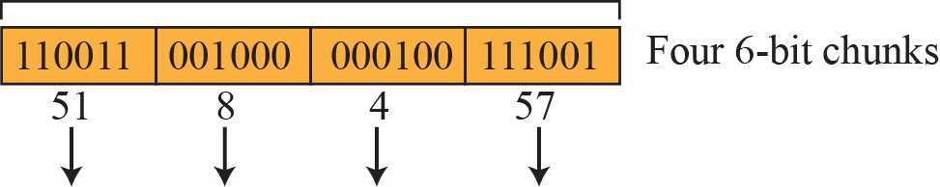
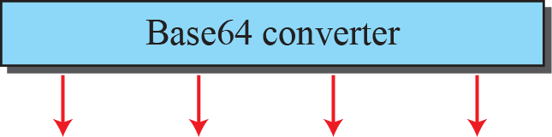

Base64 conversion

Slide 36
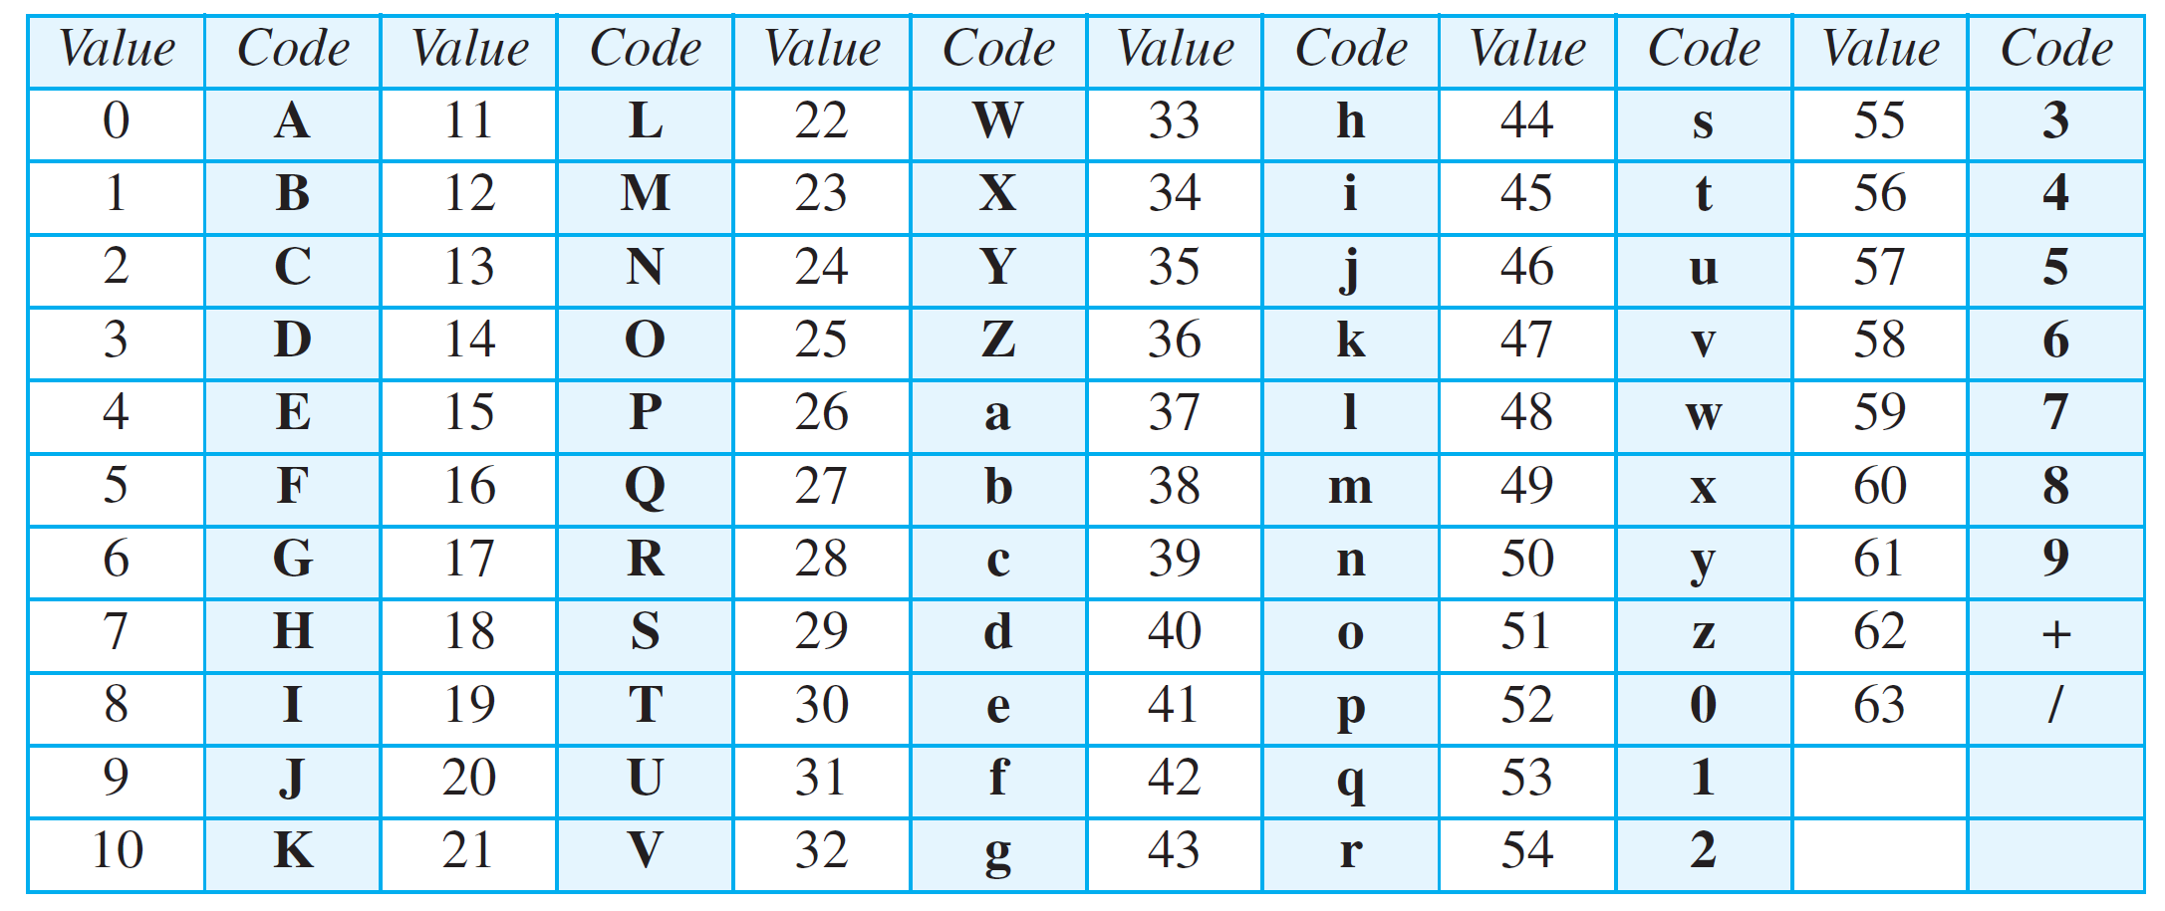
Base64 Converting Table

Slide 37
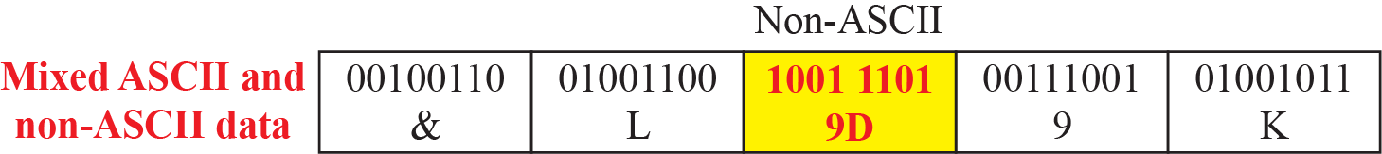
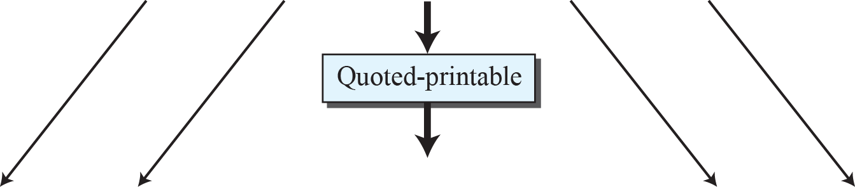
Quoted-printable
Only non-ascii characters are represented as 3 characters

Slide 38
E-Mail Security
Two of these protocols,
Pretty Good Privacy (PGP)
Secure/Multipurpose Internet Mail Extensions (S/MIME)

Slide 39
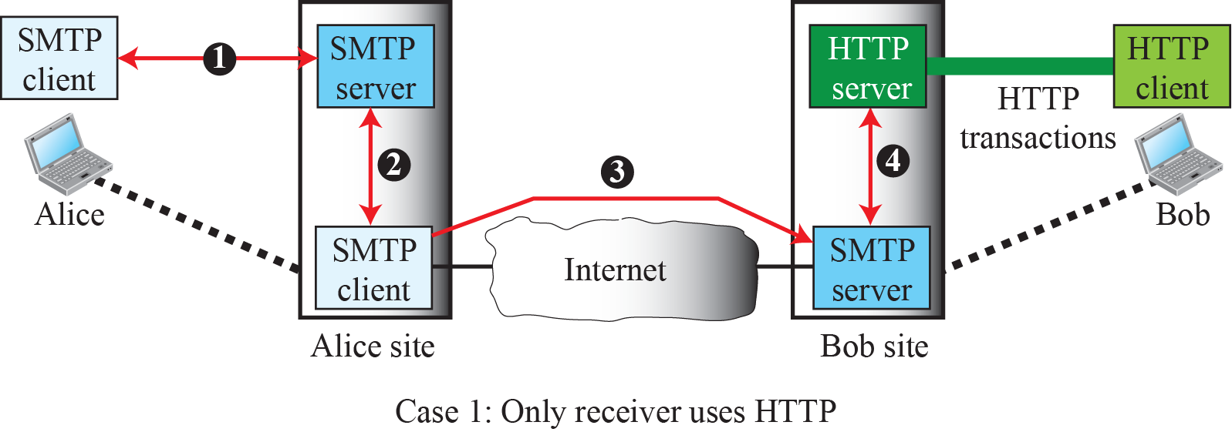
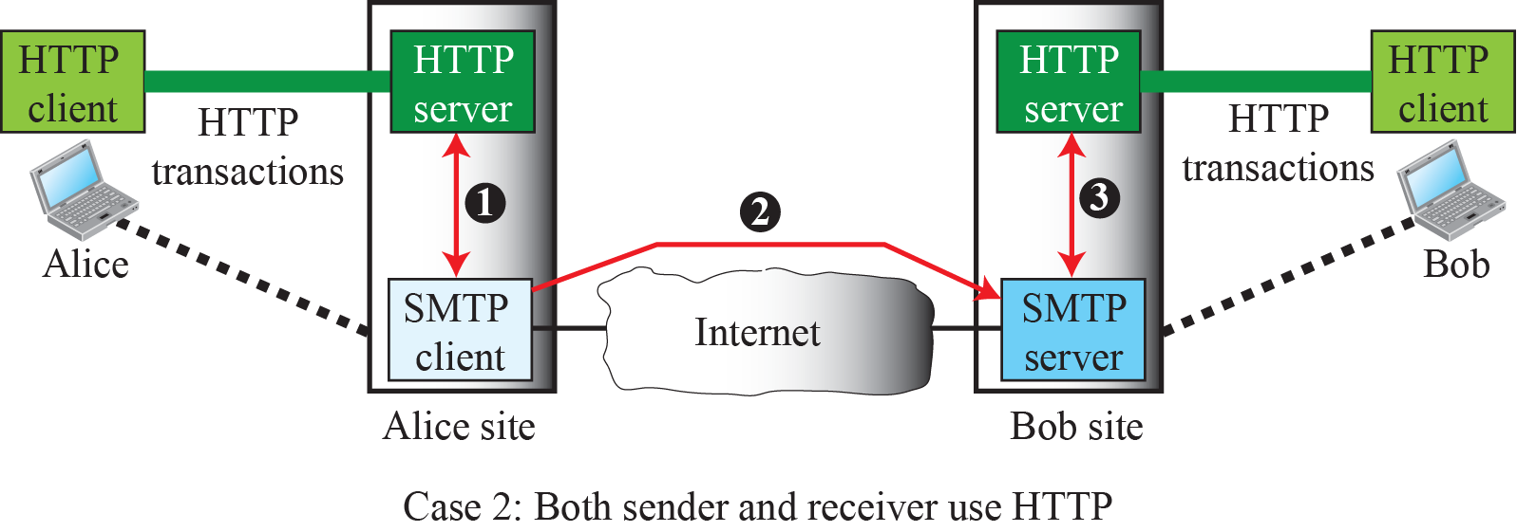
Web based e-Mail Security, cases I and II

Slide 40
TELNET
It is impossible to have a client/server pair for each type of service we need; the number of servers soon becomes intractable. The idea is not scalable. The solution is to have a specific client/server program for a set of common scenarios, but to have some generic client/server programs for the rest.
Regging - TELNET(TErminal NETwork)

Slide 41
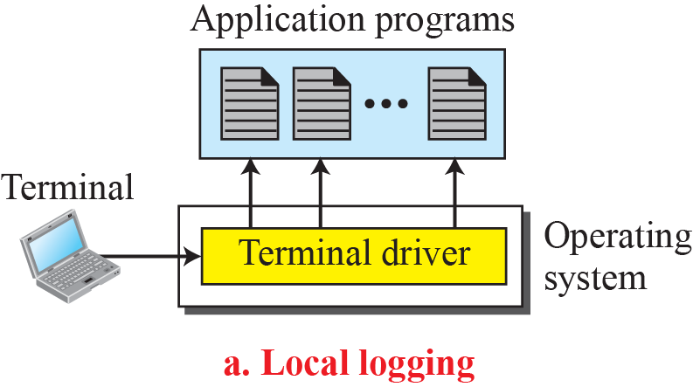

Local versus remote logging

Slide 42


Concept of NVT

Slide 43

Examples of interface commands

Slide 44
SECURE SHELL (SSH)
Secure Shell (SSH) is a secure application program that can be used today for several purposes such as remote logging and file transfer, it was originally designed to replace TELNET.
There are two versions of SSH. The first version, SSH-1, is now deprecated because of security flaws in it.

Slide 45

Components of SSH

Slide 46
SSH-Trans
Privacy or confidentiality of the message exchanged
Data integrity, which means that it is guaranteed that the messages exchanged between the client and server are not changed by an intruder
Server authentication
Compression of the messages, which improves the efficiency of the system and makes attack more difficult

Slide 47
Applications
Although SSH is often thought of as a replacement for TELNET, SSH is, in fact, a general-purpose protocol that provides a secure connection between a client and server.

Slide 48



Port Forwarding

Slide 49

SSH Packet Format

Slide 50
Check Your Understanding
What are the portocols you use while to send a mail using your browser?

Slide 51
Outcome
Student should be able to understand
FTP
Electronic Mail
Telnet
Secure Shell
SNMP

Slide 52
THANK YOU

